Slide 1
Amazon API Gateway
Lecturer: Ngo Huy Bien
Software Engineering Department
Faculty of Information Technology
University of Science
Ho Chi Minh City, Vietnam
nhbien@fit.hcmus.edu.vn

Slide 2

Objectives

Slide 3

Contents

Slide 4

References

Slide 5
Amazon API Gateway
https://aws.amazon.com/api-gateway/
Amazon API Gateway is a fully managed service that makes it easy for developers to create, publish, maintain, monitor, and secure APIs at any scale.
APIs act as the "front door" for applications to access data, business logic, or functionality from your backend services.
Using API Gateway, you can create RESTful APIs and WebSocket APIs that enable real-time two-way communication applications.
API Gateway supports containerized and serverless workloads, as well as web applications.

Slide 6
Notes
It plays a role as a web server (IIS, Apache, Nginx).
It can accept only RESTful and WebSocket connection style.
It must connect to containerized and serverless code for further processing.

Slide 7
Why API Gateway?
API Gateway handles all the tasks involved in accepting and processing up to hundreds of thousands of concurrent API calls, including traffic management, CORS support, authorization and access control, throttling, monitoring, and API version management.
API Gateway has no minimum fees or startup costs.
You pay for the API calls you receive and the amount of data transferred out and, with the API Gateway tiered pricing model, you can reduce your cost as your API usage scales.

Slide 8
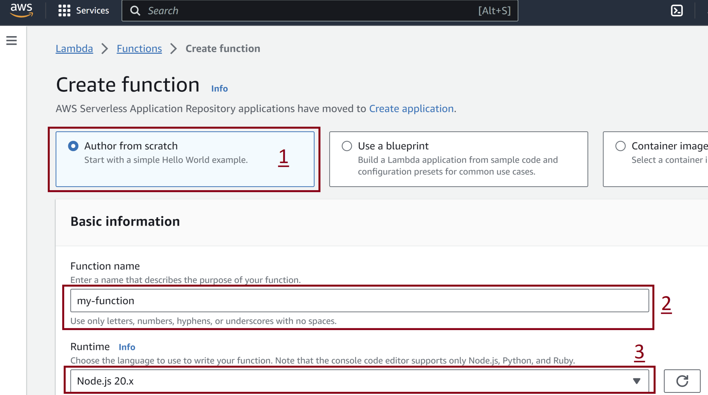
1. Create a Lambda function

Slide 9
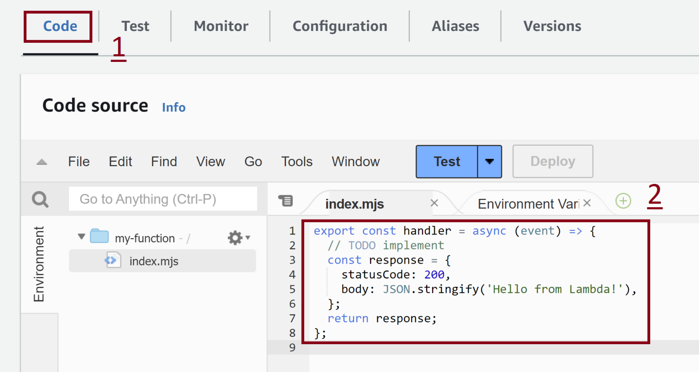
2. Review default Lambda function code

Slide 10
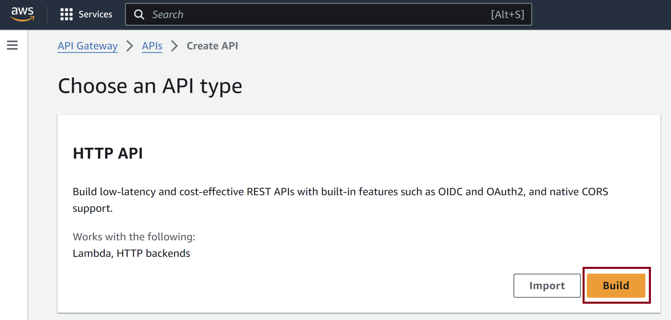
3. Create an HTTP API

Slide 11
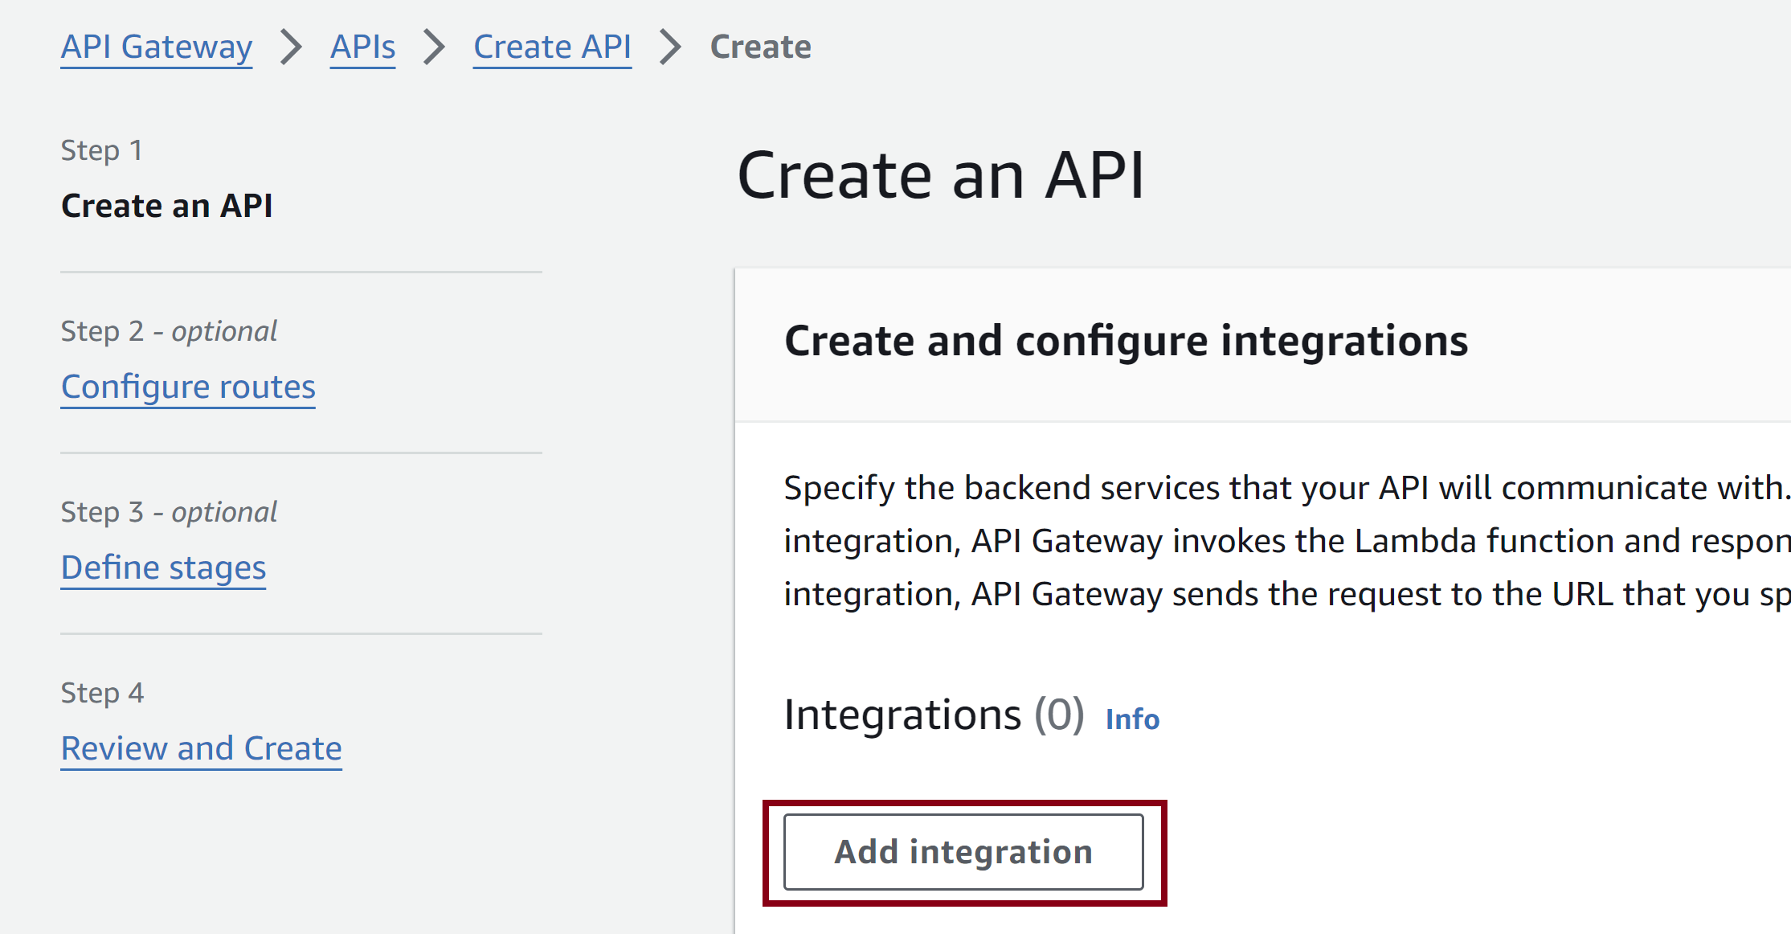
4. Add Integration for HTTP API

Slide 12
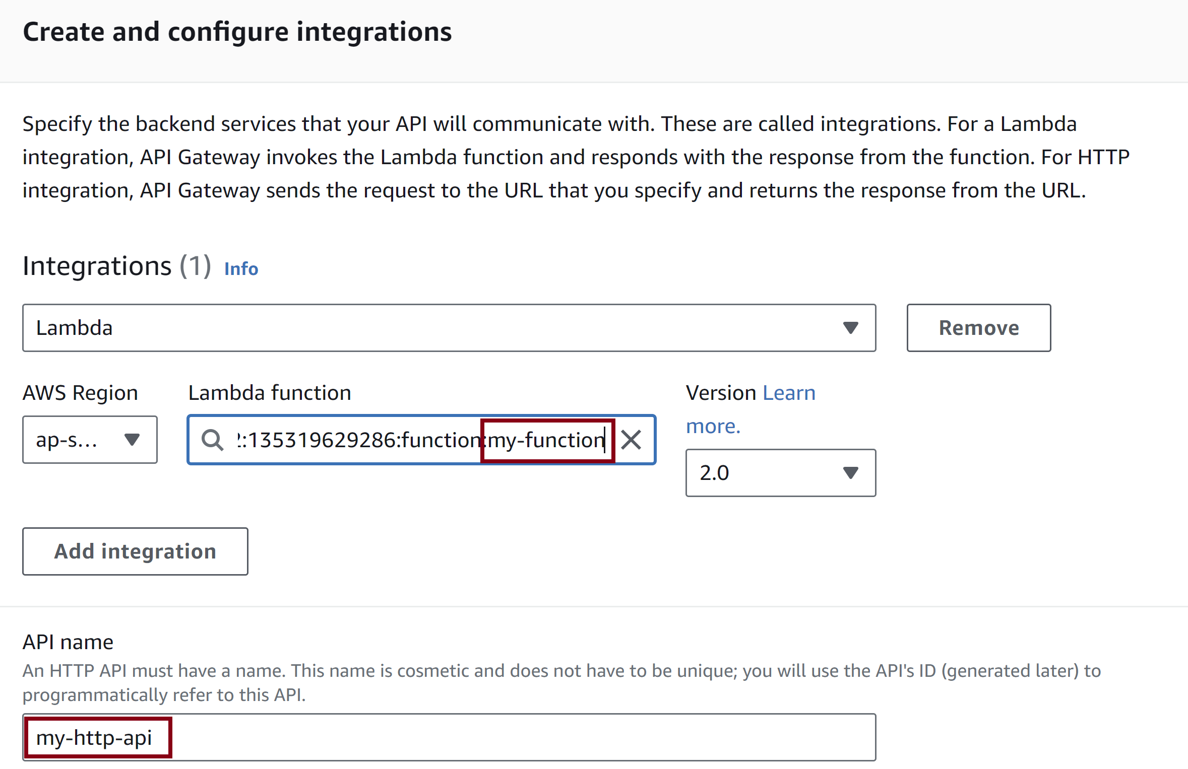
5. Configure Integration

Slide 13
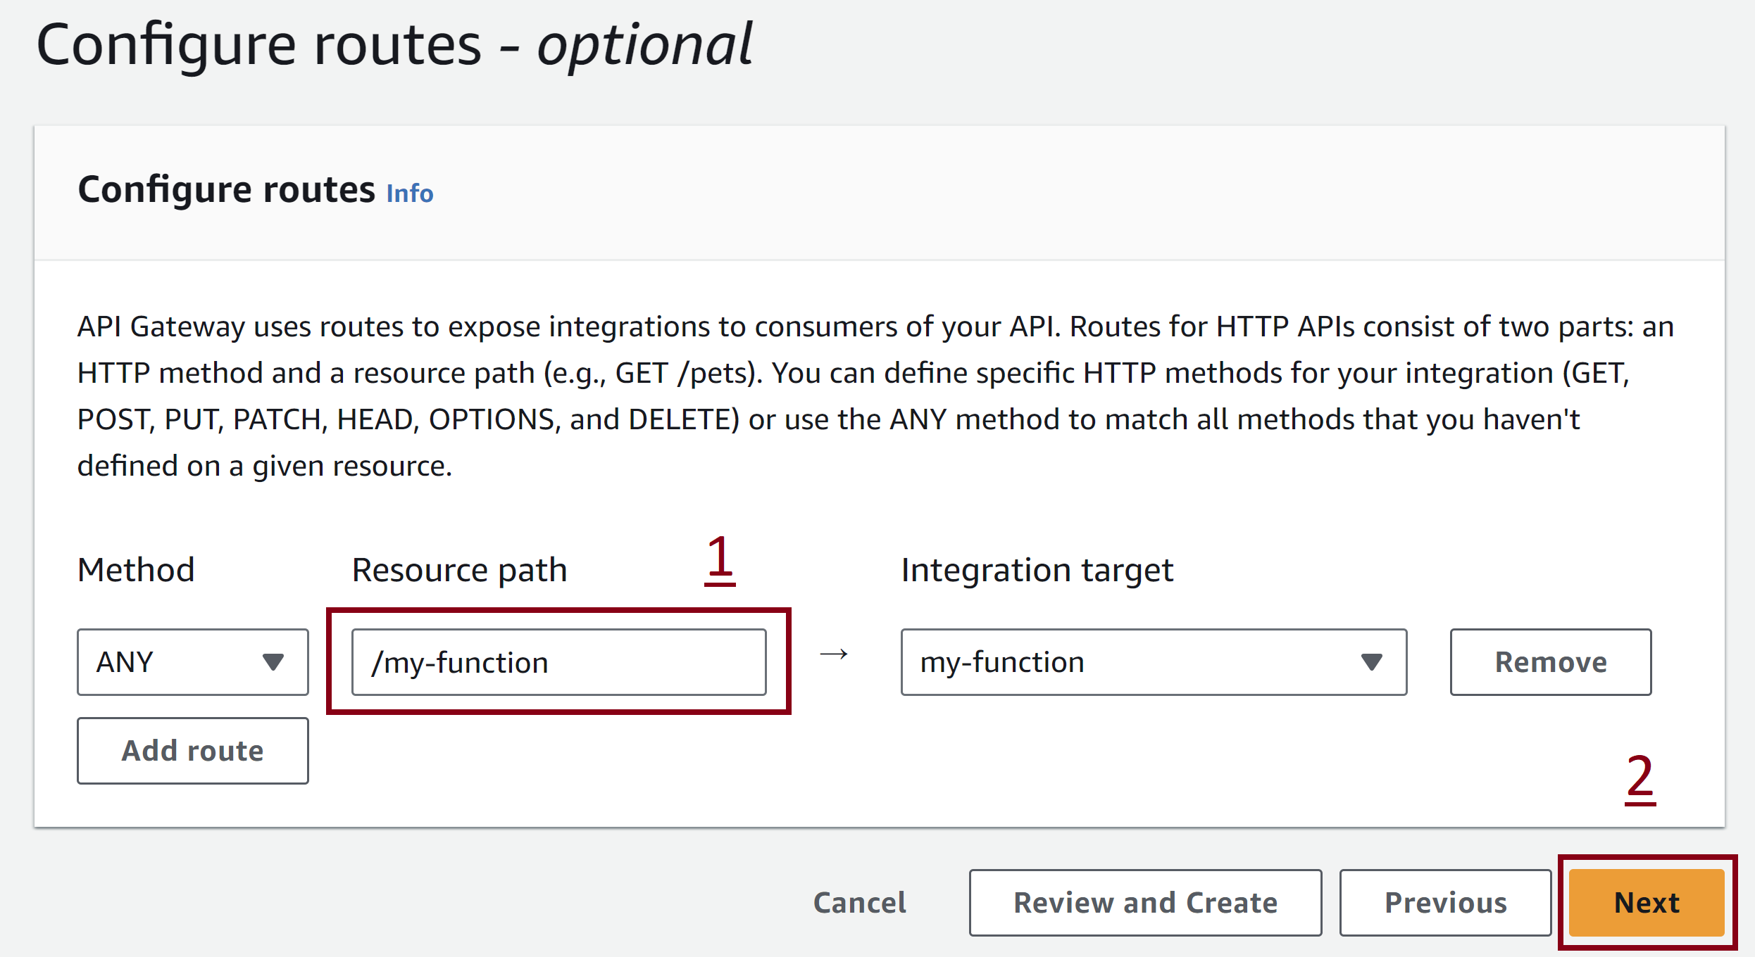
6. Configure Route

Slide 14
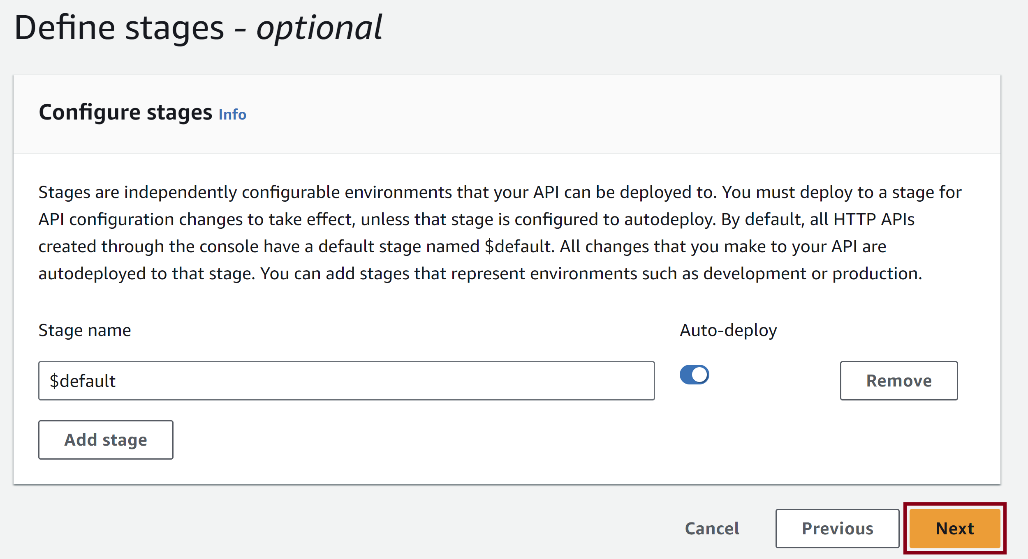
7. Define Stage

Slide 15
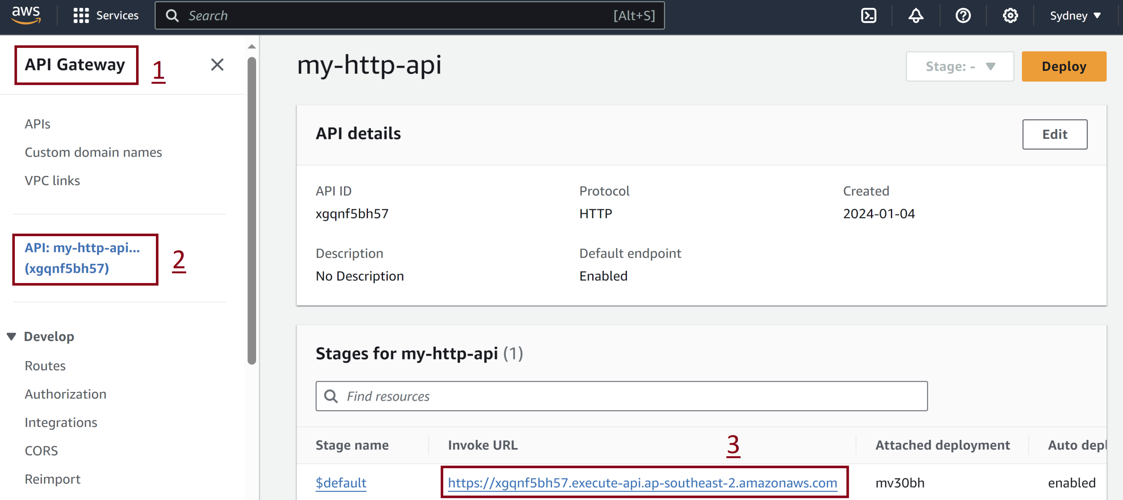
8. Retrieve Invoke URL

Slide 16
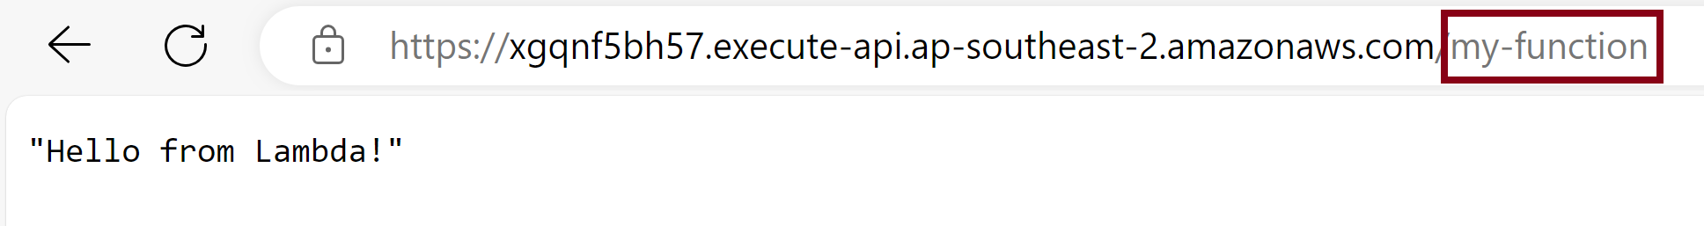
9. Append Lambda function to URL

Slide 17
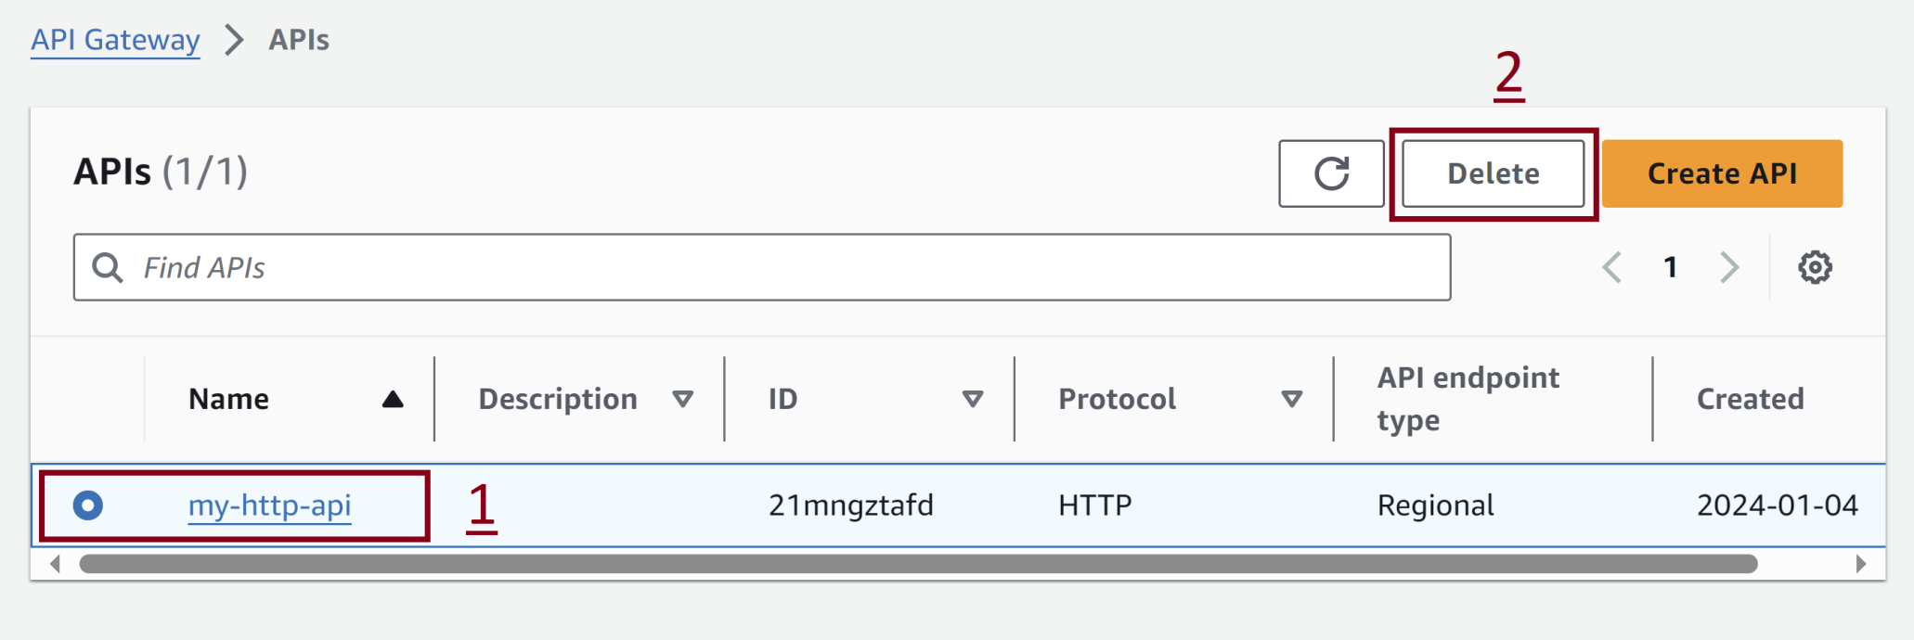
10. Remove API Gateway

Slide 18
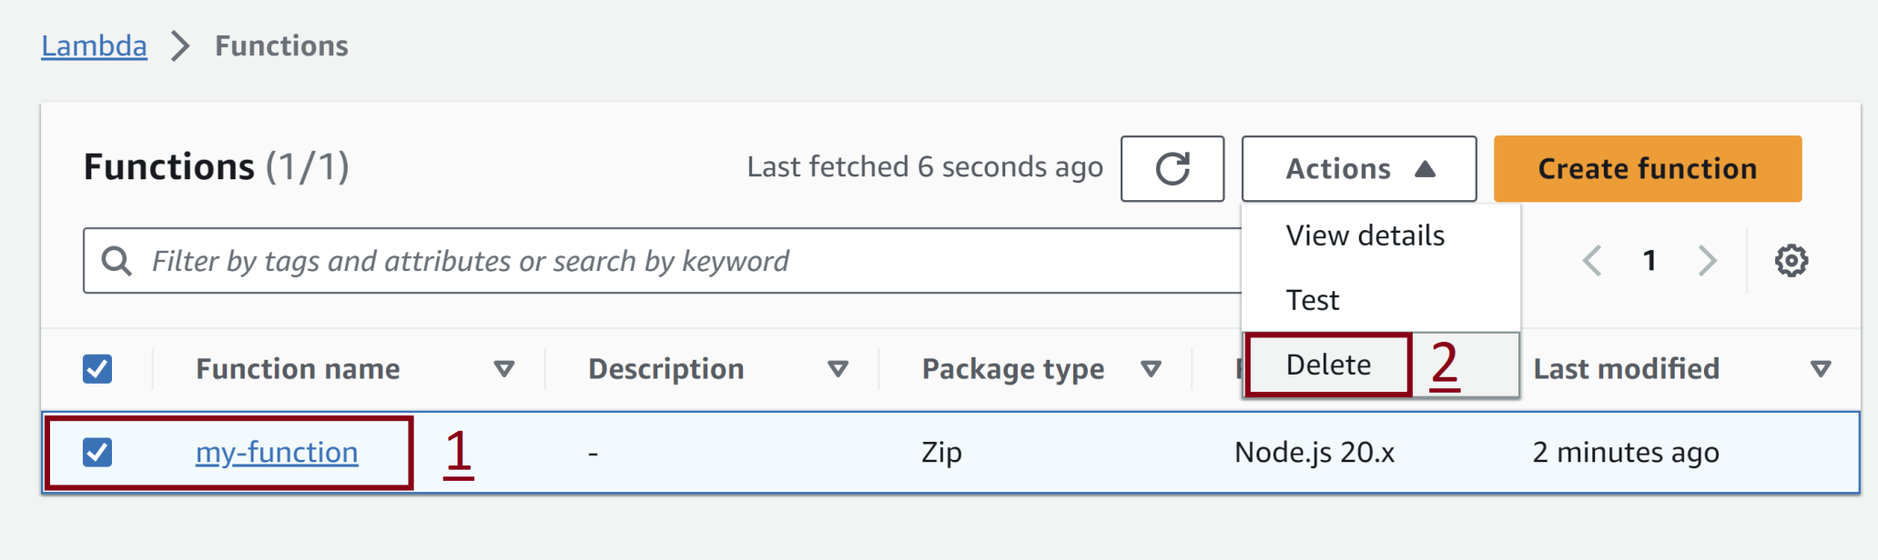
11. Remove Lambda Function

Slide 19
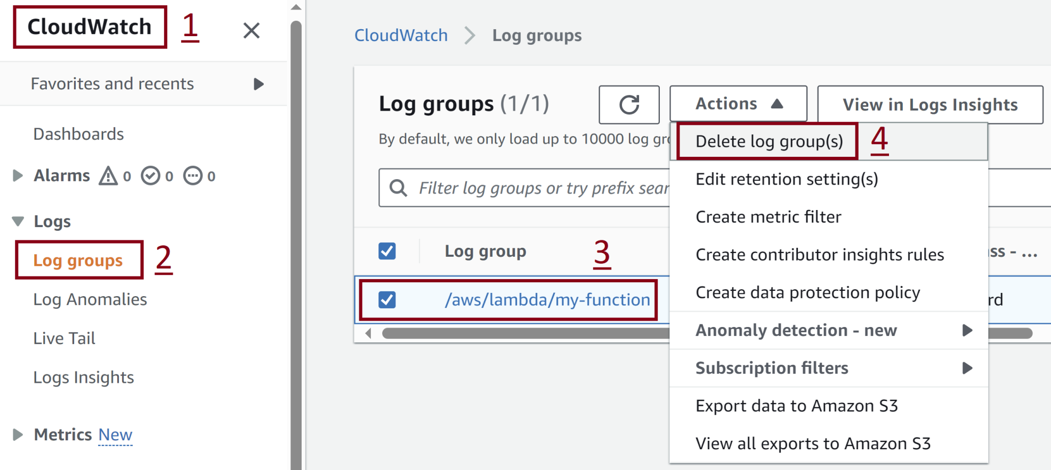
12. Remove Lambda Log Group

Slide 20
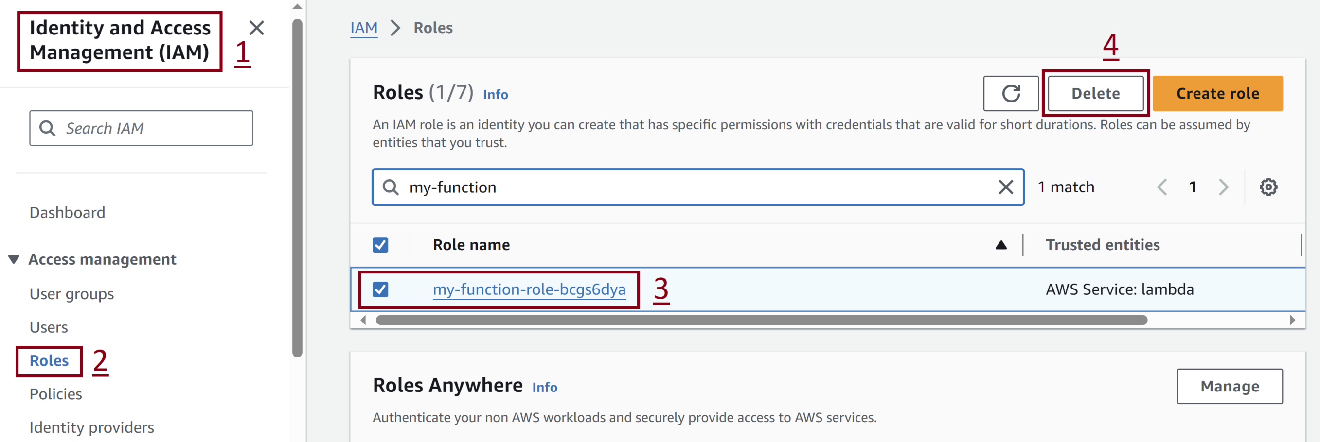
13. Remove Lambda Execution Role

Slide 21

Thank You & See You Again

